Slide 1
JavaScript
the language that turns static pages into living, breathing experiences on the web.

Slide 2
History
created in May 1995 by Brendan Eich at Netscape, and astonishingly, its first working version was built in just 10 days.

Slide 3
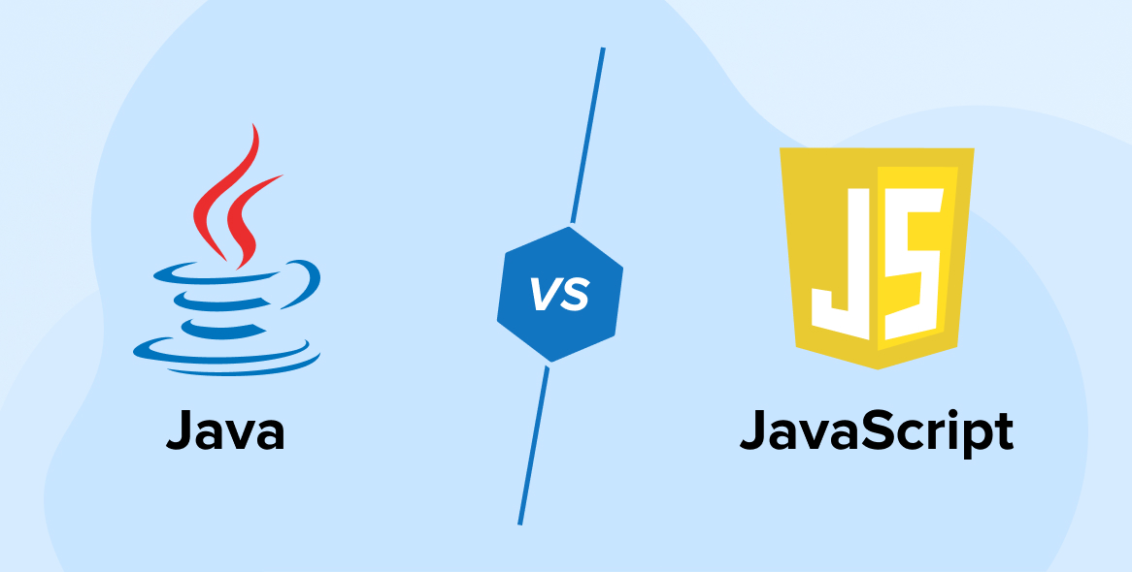
Javascript and Java

Slide 4
Data types
1. Number – integers and floating-point numbers (e.g., 42, 3.14)
2. BigInt – integers larger than Number.MAX_SAFE_INTEGER (e.g., 9007199254740991n)
3. String – text (e.g., "Hello World")
4. Boolean – true or false
5. Undefined – a variable that has been declared but not assigned
6. Null – represents “no value”
7. Symbol – unique and immutable identifiers (e.g., Symbol('id'))
8. Object – collections of key-value pairs or complex data (e.g., {name: "Alice"})

Slide 5
Check data type
Typeof <variable>

Slide 6
Variable
A variable is a named container in JavaScript that stores data values which can change during program execution.

Slide 7
Variables
var
let
const

Slide 8
Declaration vs Initialization
var a – declaration
var a = 5 - initialization

Slide 9
Hoisting
console.log(value)
var data = ’myData’

Slide 10
Window object
The window object in JavaScript represents the browser’s global context, giving access to the browser’s features, methods, and the DOM.

Slide 11
Template Literals
const name = "Alice";
console.log(`Hello, ${name}!`)

Slide 12
Operators
Arithmetic (+, -, *, /, %)
Assignment (+=, -=, *=, /=)
Comparison (==, !=, >, <, >=, <=)
Logical (&&, ||, !)
String (+)
Ternary (?:)

Slide 13
If Statement
if (x > 5) { console.log("x > 5"); }

Slide 14
If-Else Statement
if (x > 15) { console.log("x > 15"); }
else { console.log("x <= 15"); }

Slide 15
Else-If Statement
if (x > 15) { console.log("x > 15"); }
else if (x === 10) { console.log("x is 10"); }
else { console.log("x < 10"); }

Slide 16
Switch statement
let day = 3;
switch(day) {
case 1: console.log("Monday"); break;
case 2: console.log("Tuesday"); break;
case 3: console.log("Wednesday"); break;
default: console.log("Other day");
}

Slide 17
For loop
for (let i = 0; i < 5; i++) { console.log(i); }

Slide 18
While Loop
while (i < 5) { console.log(i); i++; }

Slide 19
Do-While Loop
let j = 0;
do { console.log(j); j++; } while (j < 5);

Slide 20
Break Statement
for (let i = 0; i < 10; i++) {
if (i === 3) break;
console.log(i);
}

Slide 21
Continue Statement
for (let i = 0; i < 5; i++) {
if (i === 2) continue;
console.log(i);
}

